Slide 1
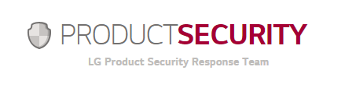
BEYOND NEWS POST #1
With mobile security issues increasingly becoming a regular part of our lives, it is more important for consumers and organizations to be more transparent and work closer together to stay on top of the rapidly changing landscape.
To that end, LG Electronics would like to announce the opening of its own product security site to act as the first point of contact for all security issues related to LG mobile products. The site https://lgsecurity.lge.com will be managed by LG’s own Product Security Response Team (PSRT) and includes information in the following categories: Security News, Response Process, Security Bulletins and Security Issues Reporting.
LG’s Product Security website will regularly publish bulletins and updates regarding security issues in LG products and details that can make our customers’ experience with LG mobile devices a safe and secure one. The website will include issues related to Android that are issued by Google with the most critical vulnerabilities listed first, followed by those deemed high, moderate and low threats.
Customers or researchers who believe they have discovered a possible security flaw in an LG mobile product are encouraged to contact LG’s Product Security Response Team at product.security@lge.com.
Notes:
자사 제품 보안 이슈 발생 시

